Slide 1
“A study on hiring process at PayTM (A subsidiary of One97 Communications)”
ABHISHEK DAS.
MBA 1st Semester.
Ashoka 1.
Roll No. – 02.
Eastern Institute for Integrated Learning in Management , Kolkata.
(Affiliated to Vidyasagar University, 2020)

Slide 2
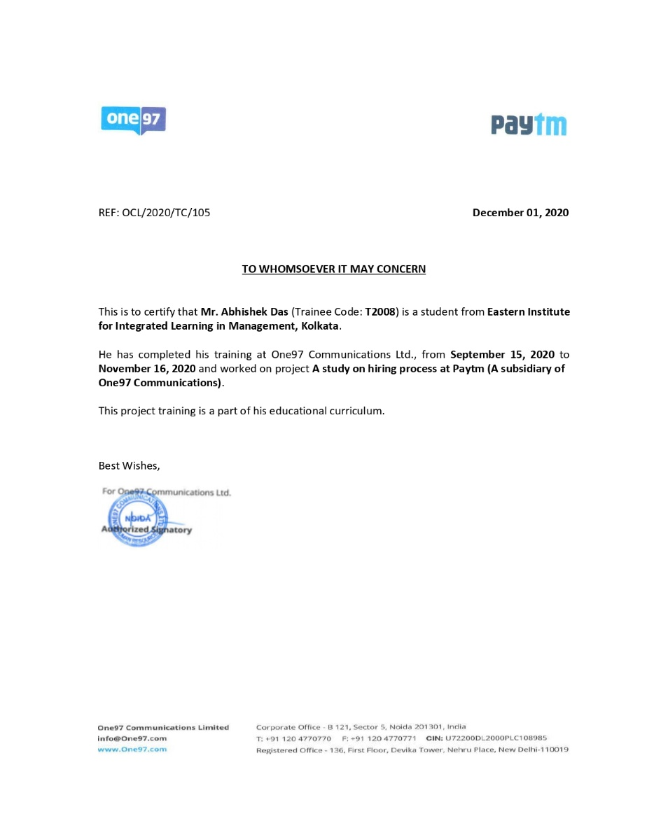
Letter of Acknowledgement

Slide 3
Brief Profile of the Company
Founded by Vijay Sekhar Sharma on August 2010 with an initial investment of $2 Million.
PayTM started as online mobile recharge and DTH recharge platform.
In 2013, the features of data recharge, landline bill payment and post-paid mobile recharge were added.
In 2014 , the features of online deals, education fees, metro recharges, electricity, gas, water and bill payments and bus ticketing were added.
In the same year, PayTM wallet was launched as a payment method for various services including Uber and Indian Railways.
Softbank, Alibaba Group, Berkshire Hathaway, SAIF Partners and ANT financials are the major investors.
PayTM is the pioneer among e-commerce platforms in India

Slide 4
Objectives of the study
To undertake interview of the potential candidate for a particular job position and evaluate them on the basis of the criteria set by the company.
To schedule the interviews for the potential candidates as per database provided by the company
To undertake reference check of the potential candidates who would be hired on behalf of the company.

Slide 5
Methodology
Total Candidates Interviewed- 100.
Sector- Collections.
Job Position- ACM & ZCM
Preferred Geographical Locations- Delhi-NCR 19%, Mumbai 7%, Chennai 5% Kolkata 3%, Pan-India 8%, rest are for various Tier 1 cities
Total Candidates Interviewed- 50.
Sector- Sales.
Job Position- Sales Manager.
Preferred Geographical Locations- Bangalore- 36%, Mumbai 32%, Chennai 14% Kolkata 22%, rest are for various Tier 1 cities

Slide 6
Methodology
Preliminary Interview Processes:
Logging in Naukri.com and starting Resdex
Inputting criteria such as CTC, location, previous company etc.
Calling the candidates individually to check if they are interested for the role, and confirming key information.
If communication skills are good then enter the names into the database.
Submitting the report to the manager.
Produce the resultant data set in an excel sheet, often with comparative graphs.

Slide 7
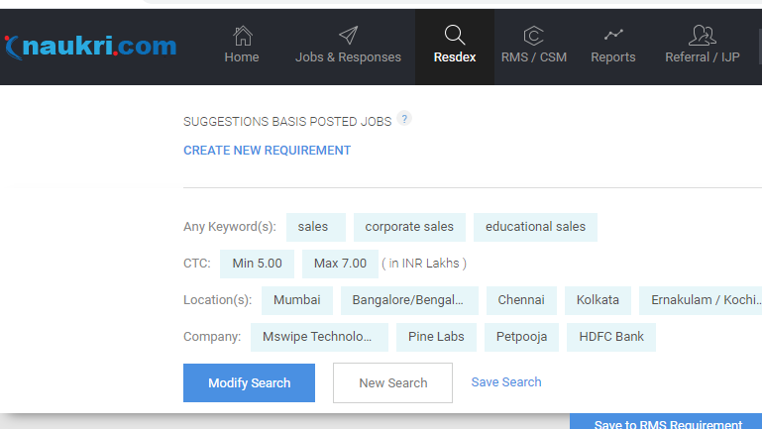
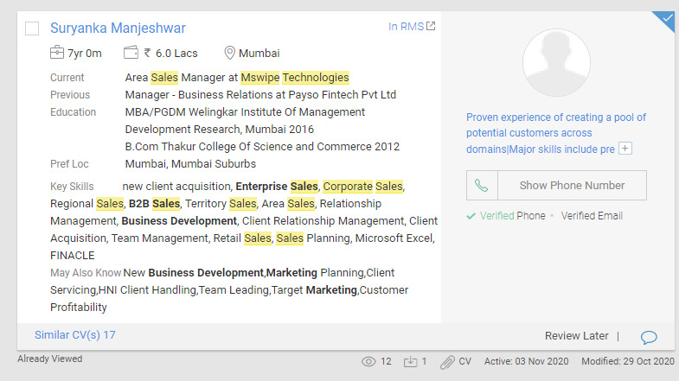
Methodology
Searching and downloading CVs from Naukri using Resdex:
Resdex Resume search
A typical candidate profile

Slide 8
Methodology
Reference Check process
Getting the necessary information from the manager
Calling the references individually to check if they knew the candidate.
Asking the references specific questions and evaluating various attributes
Submitting the report to the manager.
Produce the resultant data set in a word file in the form of a report.
.

Slide 9
Methodology
Interview Scheduling Process
Getting the information about the candidates selected in 1st round.
Calling the candidates individually to check if they are available for the interview.
Guiding the candidates through Google Meet and reschedule if required
Updating the candidate with feedback (if any).

Slide 10
Data Presentation
Preliminary interview data of one batch of candidates for collections profile are as follows:-

Slide 11
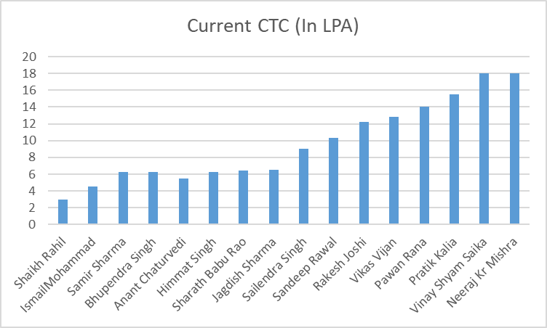
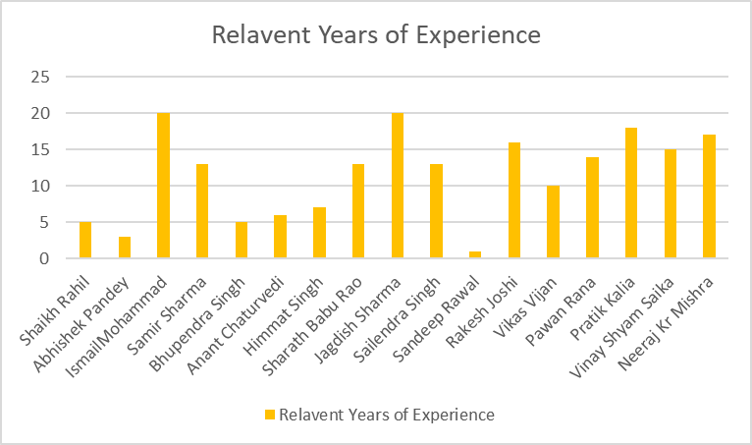
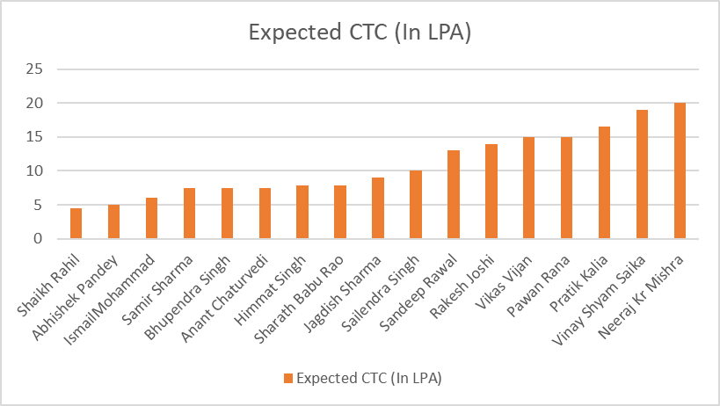
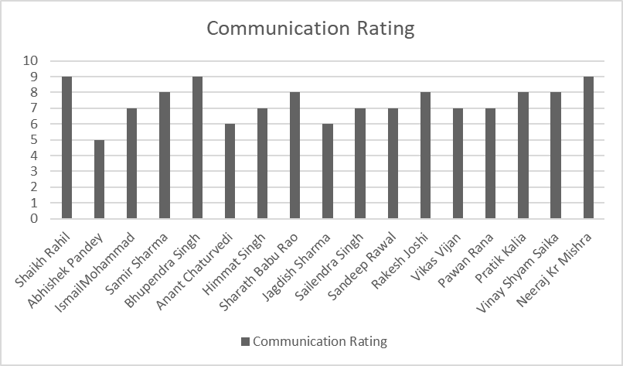
Data Presentation

Slide 12
Data Presentation
Preliminary interview data of one batch of candidates for Sales profile are as follows:-

Slide 13
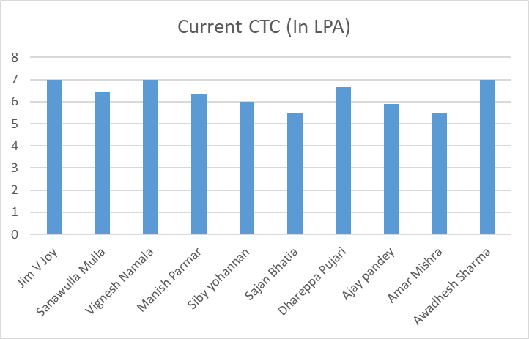
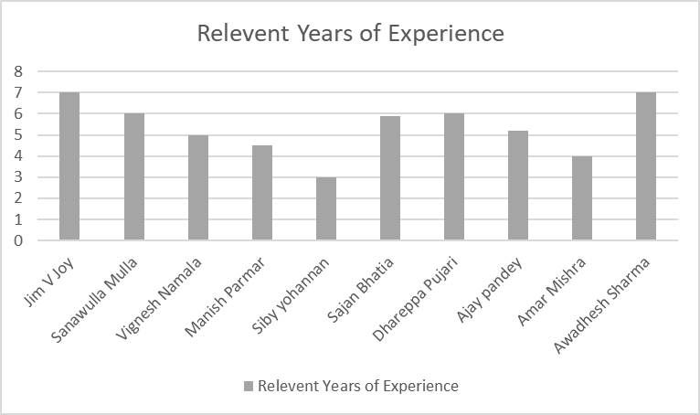
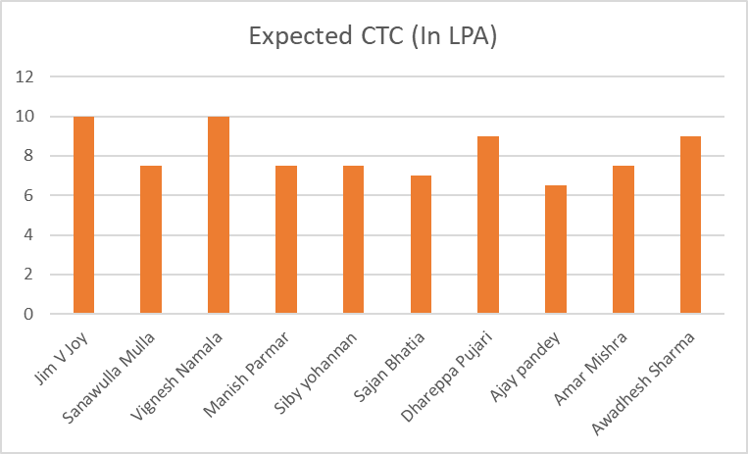
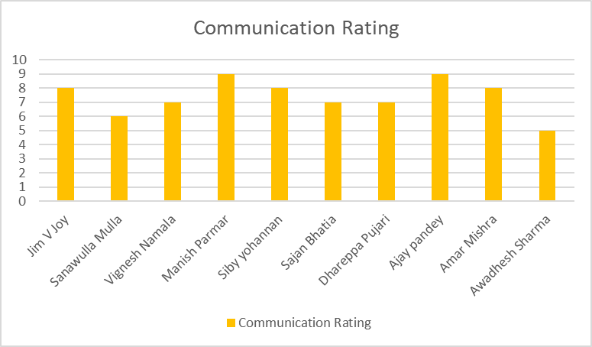
Data Presentation

Slide 14
Data Presentation
Interview Schedule Report:-

Slide 15
Analysis and Findings
Collections Profile
Sales Profile
Inferences:-
The salary package that the candidate demands is directly proportional to the relevant experience the candidate has.
Discrepancies are found in some rare cases when the candidate is from a premier institute.

Slide 16
Analysis and Findings
Collections Profile
Sales Profile
Inferences:-
Candidates do not necessarily develop good communication skills with time.
Communication skills might have been ignored before, but in the New Normal, it’s absolutely essential.
Low communication skills rating is detrimental even for an experienced candidate.

Slide 17
Observations
Communication skills is one of the most important attribute considered during preliminary selections.
Candidates are reluctant to relocate from their preferred geographical location.
Candidates unemployed due to the pandemic are less prone to negotiate for salary package.
Candidates already in a secure job position are reluctant for a change during these tumultuous times.
Job position is an important criteria a candidate looks for during change of employment.
Candidates are more reluctant to communicate during the starting and ending of the work-hours.
During the month-end, any candidate is unavailable for an interview.

Slide 18
Suggestions
Synchronization between various departments in regards to availability while conducting interviews.
Proper feedback mechanisms.

Slide 19
Challenges Faced
Language barrier with the candidates.
No definite working hours.
Uncooperative Interviewees.

Slide 20
My Learnings
To communicate with potential candidates with all over the country.
To conduct preliminary interviews of potential candidates.
To scour for candidates w.r.t several attributes by using proper tools at job portals like Naukri.com
To prepare attribute-based reports of the interviewed candidates.
To schedule interviews of potential candidates with department head and maintain an upgradable report
To perform reference check of a candidate and submit the findings in a report form.
To be able to answer any query of the candidate such as job description, location, position etc.

Slide 21
Conclusion
The main objective of this project report was to understand the functioning and responsibilities of an Human Resources professional during the hiring process in a major company like PayTM.
Working from inside the department, the nuances, the nitty gritty details of the workings of the Talent acquisition arm of the HR Department were understood.
Several eye-opening inferences were drawn while being a part of the recruitment process of a great organisation like PayTM, the pioneer of digital transaction in India.
In all, the whole internship program helped me gather valuable knowledge which will be of great help during my later corporate life.

Slide 22
Thank You

